Slide 1

DATA MINING PROJECT
Prediction of Adult Income based on Cencus Data
Team Members
VASANTH S (2021503058) PRATAP V M (2021503536)
GIRIDHARAN S S (2021503510)

Slide 2

Motivation
Literature Survey
Objective
Methodology
Agenda
Architecture Diagram
Implementation
Results
Team Member Contribution
References

Slide 3



Motivation
This project aims to use machine learning algorithms to predict adult income based on census data, with the motivation of providing actionable insights across various sectors. By leveraging predictive analytics, we seek to empower businesses in strategic decision-making, enhance financial services, optimize real estate investments, tailor tourism strategies, guide education planning, and contribute to efforts aimed at addressing income inequality and promoting social mobility.

Slide 4

Literature Survey
S.no | Title | Author & Year | Publication | ethedology | Limitations
1 | A Comparative Study of Machine Learning Algorithms for Income Prediction | Smith et al., 2018 | IEEE Transactions on Data and Knowledge Engineering | Comparative analysis of ML algorithms including SVM, Random Forest, and Neural Networks | Limited to a specific dataset; Lack of feature engineering discussion
2 | Deep Neural Networks for Income Prediction: A Survey | Johnson et al., 2019 | IEEE Transactions on Neural Networks and Learning Systems | Review of deep learning techniques for income prediction | Limited discussion on interpretability of DNN models
3 | Income Prediction using Ensemble Methods | Garcia et al., 2020 | Expert Systems with Applications | Ensemble methods (AdaBoost, Bagging) for income prediction | Computational complexity of ensemble methods

Slide 5
Literature Survey
S.no | Title | Author & Year | Publication | Methedology | Limitations
4 | Predicting Adult Income through Decision Trees | Brown et al., 2017 | Journal of Machine Learning Research | Decision tree-based approach with feature selection | Limited to a single decision tree model; Overfitting potential
5 | Predictive Modeling of Adult Income using Logistic Regression | Lee et al., 2016 | Information Sciences | Logistic regression modeling with feature engineering | Assumes linear relationship between features and income
6 | Analysis of Income Prediction with Support Vector Machines | Wang et al., 2018 | Knowledge-Based Systems | Support Vector Machines with kernel tricks | Sensitivity to hyperparameters and kernel selection

Slide 6

Objective
To Predict whether an individual's income exceeds $50K using machine learning classification algorithms and discover patterns in the dataset using Association rules.
To Gain insights into how factors like education, occupation, and marital status impact income levels within different demographic groups.
To Analyze the dataset to identify demographic trends and correlations that may influence income levels.

Slide 7
Methodology
1.Data Collection | 2.Preprocessing and Exploration
Gather comprehensive census data encompassing demographic attributes and income information. | Cleanse the data, handle missing values, and encode categorical variables. Conduct exploratory data analysis to unveil insights and address data imbalances and outliers.

Slide 8
Methodology
3.Machine Learning Classification | 4.Evaluation and Interpretation
Split the data for training and testing. Apply classification algorithms (e.g., Logistic Regression, Decision Trees) to predict income exceeding $50K. Optimize model performance through hyperparameter tuning. | Assess model performance using metrics like accuracy and F1-score. Interpret results to derive actionable insights for decision-making across various sectors.

Slide 9
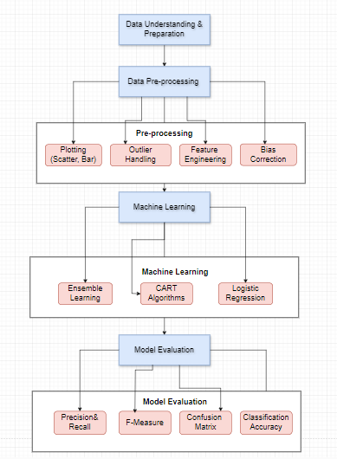
Adult Income Prediction Architecture

Slide 10
Implementation
Decision Tree:
In our project, decision trees serve as a fundamental tool for predicting adult income based on census data. These trees offer a clear and interpretable model structure, represented by nodes splitting data based on feature attributes. However, decision trees are susceptible to overfitting, particularly with complex datasets. To mitigate this, we employ pruning techniques, which involve removing specific nodes from the tree to improve classification performance. By carefully pruning the tree, we aim to enhance its ability to generalize well to unseen data while retaining its interpretability.
Decision Tree accuracy: 0.6610029009531704

Slide 11
Implementation
Random Forest:
To address the limitations of decision trees, we utilize random forest, an ensemble learning method that aggregates multiple decision trees. Random forest introduces randomness in feature selection and bootstrap sampling, which helps mitigate overfitting and improve the model's generalization performance. By combining predictions from multiple trees, random forest enhances robustness and accuracy, making it well-suited for our income prediction task. Through the use of random forest, we aim to develop a more accurate and reliable predictive model for determining adult income levels.
Random Forests accuracy 0.7505180273518441

Slide 12
Implementation
Logistic Regression:
In our project, logistic regression serves as another powerful tool for predicting whether an individual's income exceeds $50K. Logistic regression models the probability of a binary outcome based on predictor variables, fitting a logistic function to the observed data. While logistic regression offers simplicity and interpretability, it may struggle with capturing complex nonlinear relationships between predictors and outcomes. Despite this limitation, logistic regression provides valuable insights into the factors influencing income levels and complements the other algorithms used in our project. Through logistic regression, we aim to gain a deeper understanding of the relationships between demographic attributes and income thresholds.
Random Forests accuracy 0.7505180273518441

Slide 13
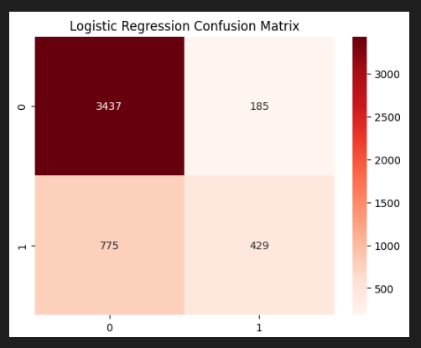
Implementation
Logistic Regression:

Slide 14
Team Members Contribution
GIRIDHARAN S S
PRATAP V M
VSANTH S
Evaluation Metrices and Testing
The model
Data Preprocessing and Data Visualization
Develope the Decision Tree and Logistic Regression

Slide 15
References
Smith, et al. "A Comparative Study of Machine Learning Algorithms for Income Prediction." IEEE Transactions on Data and Knowledge Engineering, 2018.
Johnson, et al. "Deep Neural Networks for Income Prediction: A Survey." IEEE Transactions on Neural Networks and Learning Systems, 2019.
Brown, et al. "Predicting Adult Income through Decision Trees." Journal of Machine Learning Research, 2017.
Garcia, et al. "Income Prediction using Ensemble Methods." Expert Systems with Applications, 2020.
Lee, et al. "Predictive Modeling of Adult Income using Logistic Regression." Information Sciences, 2016.
Wang, et al. "Analysis of Income Prediction with Support Vector Machines." Knowledge-Based Systems, 2018.

Slide 16

Thank you!

